Slide 1
Creative Coding Final Project Ideas
Sharon Lee

Slide 2
Idea #1: Refugee/Migrant Crisis Visualization
To place the user in the shoes of a refugee or migrant in 2015
User input : age, gender, month of 2015 year, destination country
Program output : visualize and present the statistics specifically linked to the demographic chosen (1/how many refugees total that month, percentage of your demographic in that group, number of missing people/deaths by the end of that month, etc.)

Slide 3
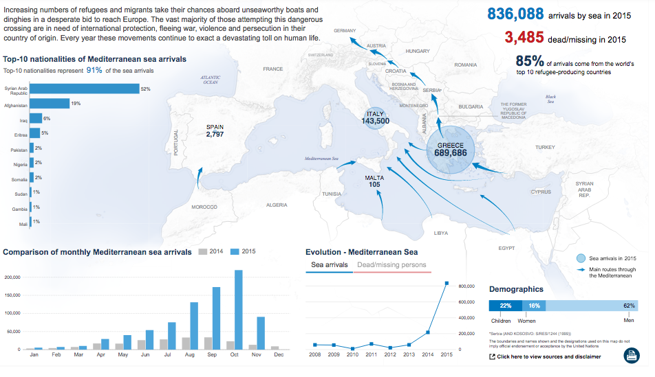
Data Reference: The UN Refugee Agency

Slide 4
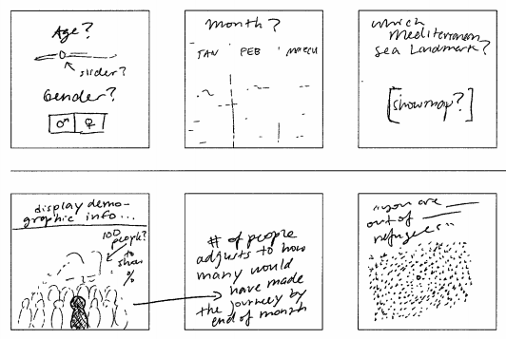
Storyboard

Slide 5

Idea #2: Balloon Game
User character goal is to continue floating with balloons upwards “Steer” with left and right arrow keys
“Enemy” class would be pointy-beaked birds flying across
Evolves and becomes more difficult the longer the player stays afloat (birds fly faster, bigger birds, wind)
Game over when there are no more balloons left

Slide 6
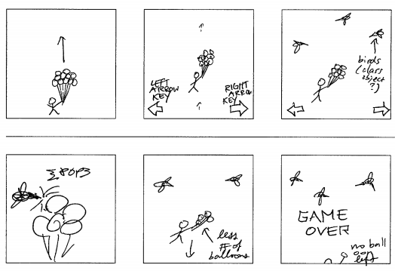
Storyboard

Slide 7
Idea #3: Children’s Story Interactive Narrative
inspo:
http://thecarpandtheseagull.thecreatorsproject.com/video.html#
http://interactive.nfb.ca/#/outmywindow
http://pinepoint.nfb.ca/#/pinepoint
Jack and the Beanstalk
http://samt.xyz/scroll

Slide 8
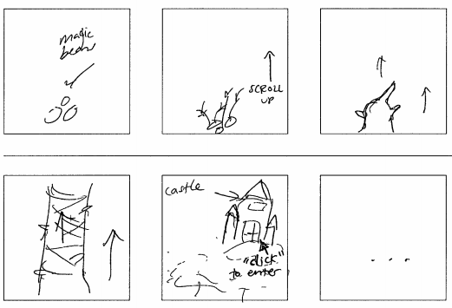
Storyboard

